Slide 1
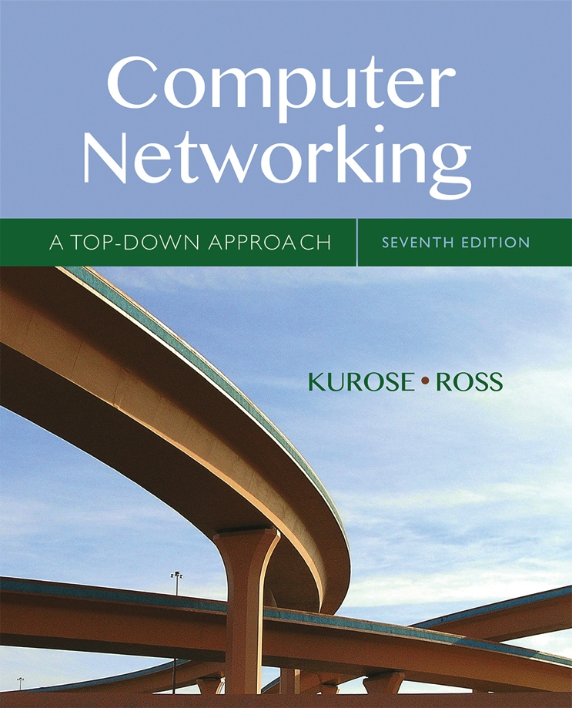

Chapter 5 Network Layer:
The Control Plane
A note on the use of these Powerpoint slides:
We’re making these slides freely available to all (faculty, students, readers). They’re in PowerPoint form so you see the animations; and can add, modify, and delete slides (including this one) and slide content to suit your needs. They obviously represent a lot of work on our part. In return for use, we only ask the following:
Computer Networking: A Top Down Approach
If you use these slides (e.g., in a class) that you mention their source (after all, we’d like people to use our book!)
If you post any slides on a www site, that you note that they are adapted from (or perhaps identical to) our slides, and note our copyright of this material.
Thanks and enjoy! JFK/KWR
All material copyright 1996-2016
J.F Kurose and K.W. Ross, All Rights Reserved
7th edition Jim Kurose, Keith Ross Pearson/Addison Wesley April 2016

Slide 2
Chapter 5: outline
5.1 introduction
Control Plane
Autonomous Systems
5.2 routing protocols
link state
distance vector
5.3 intra-AS routing in the Internet:
RIP
OSPF
5.4 inter-AS routing in the Internet: BGP

Slide 3
Network-layer functions
Recall: two network-layer functions:
forwarding: move packets from router input port to appropriate router output port
data plane
routing: determine route taken by packets from source to destination
control plane
Two approaches to structuring network control plane:
per-router control (traditional)
logically centralized control (software defined networking)

Slide 4

Per-router routing to forwarding mapping
Routing algorithm components in each and every router interact/exchange information via the control plane – create routing table
Each and every router translates routing algorithm output into port mapping information to create forwarding table
Routing
Algorithm
control
plane
data
plane
values in arriving
packet header
0111
1
3
2

Slide 5
Scalability
the Internet (network of networks) is:
diverse – large variety of devices
vast – billions of non identical devices
scale: with billions of destinations:
can’t store all destinations in routing tables!
routing table exchange would swamp links!
administrative autonomy
the Internet = network of networks
networks -> autonomous entities
each network admin controls routing and other functions within its own network

Slide 6
Internet approach to scalable routing
aggregate routers into regions known as “autonomous systems” (AS) (a.k.a. “domains”)
an autonomous system (AS) is a region of the Internet that is administered by a single entity and that has a unified routing policy
each autonomous system is assigned an Autonomous System Number (ASN). Each ASN is 32bits
ASN assigned by Regional Internet Registries
example ASNs
U of Ts campus network (AS239)
Sprint (AS1239, AS1240, AS 6211, …)
each autonomous system can consist of multiple IP networks

Slide 7
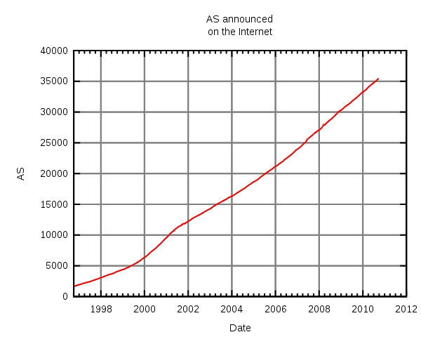
Number of Autonomous Systems
The number of unique autonomous networks
in the routing system of the Internet exceeded 5,000 in 1999,
30,000 in late 2008, 35,000 in mid-2010, 42,000 in late 2012,
54,000 in mid-2016 and 60,000 in early 2018

Slide 8
Autonomous Systems terminology
Stub AS: has connection to only one other AS, only carries local traffic. It can connect to other private networks that are not seen by the Internet. (E.g., UC and CalState network - CENIC)
Multihomed Stub AS: has connection to more than one AS, but only carries local traffic
Transit AS: has connection to more than one AS and carries transit traffic, e.g., ISPs
local traffic: traffic with source and destination in AS
transit traffic: traffic that passes through the AS

Slide 9
Stub and Transit Networks
Private Network: Invisible to Internet
AS 1 is a multi-homed stub network
AS 3 and AS 4 are transit networks
AS 2 and AS 5 are stub networks

Slide 10
Routing and Autonomous Systems
intra-AS routing
routing among hosts, routers in same AS (“network”)
all routers in AS must run same intra-domain routing protocol
routers in different AS can run different intra-domain routing protocol
gateway router: at “edge” of its own AS, has link(s) to router(s) in other AS’es
inter-AS routing
routing among AS’es
there is at least one dedicated router in each AS that handles interdomain traffic – gateway router(s)
gateways perform inter-domain routing (as well as intra-domain routing)

Slide 11
Interdomain and Intradomain routing
routing protocols used inside an AS, referred to as intradomain routing, are called interior gateway protocols (IGP)
objective: shortest path, only operate within an AS
routing protocols used between ASs, referred to as interdomain routing, are called exterior gateway protocols (EGP)
objective: satisfy policy of the ASs, not always shortest path

Slide 12
Interdomain and Intradomain Routing
Intradomain Routing
protocols for Intradomain routing are collectively called Interior Gateway Protocols or IGP’s.
popular protocols are:
RIP (open source, simple, rarely used anymore)
OSPF (open source, complex, popular)
EIGRP Enhanced Interior Gateway Routing Protocol (Cisco proprietary for decades, until 2016)
Interdomain Routing
protocols are collectively called Exterior Gateway Protocols or EGP’s.
popular protocols are:
Border Gateway Protocol (BGP) v4 current
IS-IS – InterSystem routing

Slide 13
Why is Intra- different from Inter-AS routing ?
policy:
inter-AS: manager of an AS wants control over how its traffic is routed externally, and who routes through its net (not applicable for STUB networks).
intra-AS: single admin, so no policy decisions needed
scale:
information exchange – frequency, amount
performance:
intra-AS: can focus on performance (e.g., cost)
inter-AS: policy may dominate over performance

Slide 14
EGP vs IGP
1
Interior Gateway Protocol (IGP)
routing is done based on metrics
routing domain is one AS
Exterior Gateway Protocol (EGP)
routing is done based on policies
routing domain is the entire Internet

Slide 15
Interconnected ASes and forwarding
3c
3a
2c
3b
AS3
2a
1c
2b
AS2
1a
1b
1d
AS1
IP forwarding table configured by both intra- and inter-AS routing algorithm
intra-AS routing determine entries for destinations within AS
inter-AS & intra-AS determine entries for external destinations
Intra-AS
Routing
algorithm
Inter-AS
Routing
algorithm
Forwarding
table

Slide 16
Inter-AS tasks
suppose an interior router in AS1 receives datagram destined outside of AS1:
router should forward packet to gateway router, but which one?
AS1 Gateway Routers must:
learn which destinations are reachable through AS2, and which through AS3
propagate this reachability info to all routers in AS1
job of inter-AS routing!
3c
3a
3b
AS3
2c
other
networks
1c
2a
other
networks
1a
2b
1b
AS2
AS1
1d

Slide 17
Multiple Routing Protocols
multiple routing protocols can run on the same router
but only one IGP protocol will be in operation in an AS
if a router is an exterior gateway router, then usually one IGP and one EGP protocol will be in operation
each routing protocol updates the routing table accordingly

Slide 18
Chapter 5: outline
5.1 introduction
control Plane
autonomous Systems
5.2 routing protocols
link state
distance vector
5.3 intra-AS routing in the Internet:
RIP
OSPF
5.4 inter-AS routing in the Internet: BGP

Slide 19
Routing protocols
Routing protocol goal: determine “good” paths (equivalently, routes), from sending host to receiving host, through network of routers
path: sequence of routers packets will traverse in going from given initial source host to given final destination host
“good”: “ least cost”, “fastest”, “least congested”

Slide 20
Components of a Routing Algorithm
a procedure for sending and receiving reachability information about a network to other routers
a procedure for calculating optimal routes
Routes are calculated using a shortest path algorithm (least “cost”)
a procedure for reacting to and advertising topology and network condition/status changes

Slide 21
Routing algorithm classification
Q: global or local information?
global:
all routers have complete topology, link cost info
“link state” algorithms
local:
router knows physically-connected neighbors, link costs to neighbors
iterative process of computation, exchange of info with neighbors
“distance vector” algorithms
Q: quasi-static or dynamic?
quasi-static:
routes change slowly over time
topology driven
dynamic:
routes change more quickly
periodic update
in response to link cost changes

Slide 22
Two Shortest Path IGP Routing Algorithms
Distance Vector Routing
each node knows the distance (cost) to its directly connected neighbors
a node periodically sends a list of routing updates to its neighbors (local)
if all nodes update their distances to destinations using neighbor information, the routing tables eventually converge
Link State Routing
each node knows the distance (cost) to its directly connected neighbors
the distance information is flooded to all nodes (global) in the network
each node calculates the routing tables independently using a network map (topology) created by the node using the global information it received
every node has a complete map of the topology and it is the same for each node

Slide 23
Comparing Link State and Distance Vector
In link state routing
each node has a complete map of the topology – flooding all link info
quick convergence
If a node fails, all other nodes can calculate a new route
Overhead: All nodes need to have a consistent view of the network -> flooding of all info
In distance vector routing
each node has information only about the next hop – local information:
Node A: to reach F go to B
Node B: to reach F go to D
Node C: go directly to F
Distance vector routing makes poor routing decisions if a change occurs, e.g., because a node is down.
local view of network, directs traffic to down node for a while
Convergence: After a change, the routing may be incorrect until the routing algorithm has re-converged.
A
B
C
D
E
F
A
B
C
A
B
C
A
B
C
Node A: to reach F go to B
Node B: to reach F go to C
D
E
F
D
E
F
D
E
F
Node A: to reach F go to D
A
B
C
A
B
C
Node C: go directly to F
D
E
F
A
B
C
A
B
C
A
B
C
D
E
F
D
E
F
D
E
F
D
E
F
Node D: to reach F go to E
Node E: go directly to F

Slide 24
Chapter 5: outline
5.1 introduction
5.2 routing protocols
link state
distance vector
5.3 intra-AS routing in the Internet:
RIP
OSPF
5.4 inter-AS routing in the Internet: BGP

Slide 25
Routing Internet Protocol (RIP)
RIP is a Distance Vector based Protocol
RIP is not much used today (cannot handle large networks), but it is great for studying principles of routing
History
Late 1960s : Distance Vector protocols were used in the ARPANET
Mid-1970s: XNS (Xerox Network system) routing protocol is the precursor of RIP in IP
1982 Release of routed for BSD Unix
1988 RIPv1 (RFC 1058)
classful routing
1993 RIPv2 (RFC 1388)
classless routing
1997 RIPng (RFC 2080)
support for IPv6
RFC 2453 RIPv2 (Current version of RIPv2)

Slide 26
RIP - Basics
it is a low overhead simple routing protocol
straightforward implementation of distance vector algorithm
route computation using Bellman Ford’s algorithm
each node periodically advertises routing information to its neighbors ONLY
disseminates its full routing table
routing table entries give distance from the node to a destination network (network ID/prefix)
the routing metric is hop count
distance is given in hop counts to a destination
maximum is 15 with 16 interpreted as ∞, ie down/unreachable

Slide 27
RIP: Advertisements and Updates
routing advertisements sent to each node’s immediate neighbors only
carried in RIP messages over UDP, port 520
unreliable communications
two types of advertisements
periodic updates - every 30secs – full routing table
triggered updates - sent when a change detected in a route metric – only affected destination in routing table is sent
routing table
contains pairs of: destination network, distance (hop count)
routing table entries are updated if
update indicates a lower cost path to a destination
if a destination is declared unreachable ∞
routes timeout (set to16) after 3 minutes if they are not updated

Slide 28
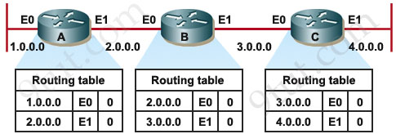
Rip Example
assume:
link cost is “1” on all hops
all updates occur simultaneously
initially each router only knows its directly connected interfaces --> cost = 0

Slide 29
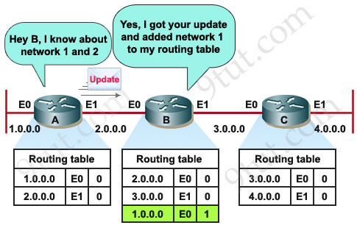
After First Update

Slide 30
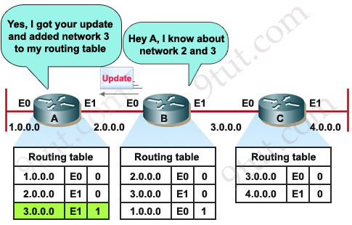
After Second Update

Slide 31
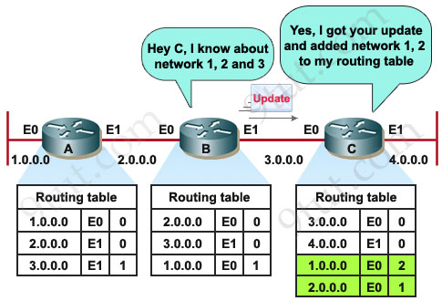
After Third Update

Slide 32
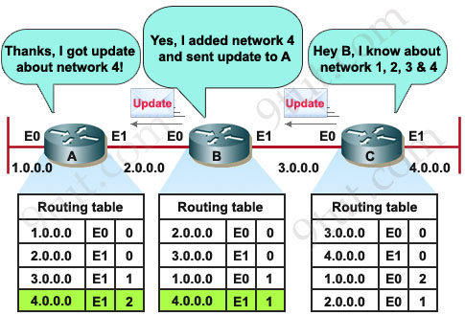
Last Update for Convergence

Slide 33

Example of RIP
14 | 0 | -
55 | 0 | -
14 | 0 | -
23 | 0 | -
78 | 0 | -
Net:14
B
Net:55
78 | 0 | -
92 | 0 | -
55 | 0 | -
66 | 0 | -
A
Net:78
F
Net:92
C
Net:23
Net:66
Net:08
08 | 0 | -
23 | 0 | -
E
D
0hop – directly connected
1hop – cross 1 router
2hops – cross 2 routers
3hops – cross 3 routers
08 | 0 | -
66 | 0 | -

Slide 34
Example of RIP
14 | 0 | -
55 | 0 | -
78 | 1 | A
23 | 1 | A
66 | 1 | C
92 | 2 | A
08 | 2 | C
0hop
1hop
2hops
0hop
1hop
2hops
3hops
14 | 0 | -
23 | 0 | -
78 | 0 | -
08 | 1 | E
55 | 1 | B
92 | 1 | F
66 | 2 | E
Net:14
B
Net:55
78 | 0 | -
92 | 0 | -
14 | 1 | B
08 | 1 | D
23 | 2 | D
78 | 2 | B
92 | 3 | B
A
Net:78
Net:92
F
C
Net:23
Net:66
Net:08
E
D

Slide 35
Convergence and Loops
Distance Vector Protocols are subject to loop formations because of the myopic view of each router
routers only hear from neighbors and use that to create a global connectivity map
when network changes occur, triggered advertisements are used to inform neighbors
take a while to propagate and during that time cycles can form
one particular issue is the count to infinity problem, updates, triggered by a network change, bounce back and forth between routers, constantly incrementing in distance value
creeps up with no end in sight
to counter that, a maximum value was introduced that once it is reached, the destination is considered to be unreachable and the route is removed from the routing table.
the maximum value is 16

Slide 36
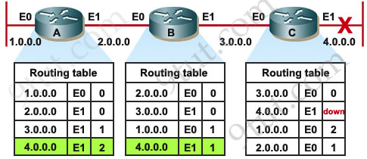
Example of Count to Infinity: Trigger - Down Link
1
1
Link to network 4.0.0.0 goes down at Router C
Router C marks in its routing table that Net 4.0.0.0 is down
i.e., cost is now “infinity =16 in RIP”

Slide 37
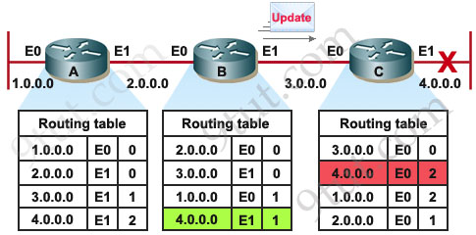
Down Link – Updates: Periodic and Triggered
C detects down link, normally sends a triggered update to notify neighbors – here Router B but…..
C receives a periodic update from B with info re 4.0.0.0
no time to broadcast its BAD news
C instead uses B’s update to update its own table
sees that B is “one” hop away from Net 4.0.0.0 via its interface E0
calculates its route to NET 4.0.0.0 using B as next hop -> “1+1=2”
C updates its routing table – NET 4.0.0.0 distance 2

Slide 38
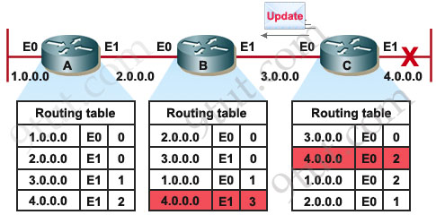
Triggered Update C to B due to route update
C send its neighbors (only B in this case) its new updated routing table When C
B sees the change in cost to NET 4.0.0.0 via C – i.e., on its interface E1
B updates its entry to Net 4.0.0.0 to “1+2=3” on E1
B shares this new update with its neighbors, including C
C sees the new distance from B -> proceeds to update its entry again for Net 4.0.0.0 (3+1=4) vis E0
B and C repeat this cycle and the distance increases in value -> when it reaches the maximum value 16 finally declared down by all.
Note: B sends updates to A, and its cost for NET 4.0.0.0 will increase correspondingly too.

Slide 39
Count-to-Infinity Phenomenon
Q: why does the count-to-infinity problem occur?
A: because each router ONLY has a “next-hop-view” and the next hop is not included in the updates, only destination network and distance to destination in hops

Slide 40
How to Prevent Count to Infinity
Enhancements proposed to prevent the Count to Infinity problem and routing loops:
Split Horizon
Route Poisoning
Reverse Poison
Hold Down Timers

Slide 41
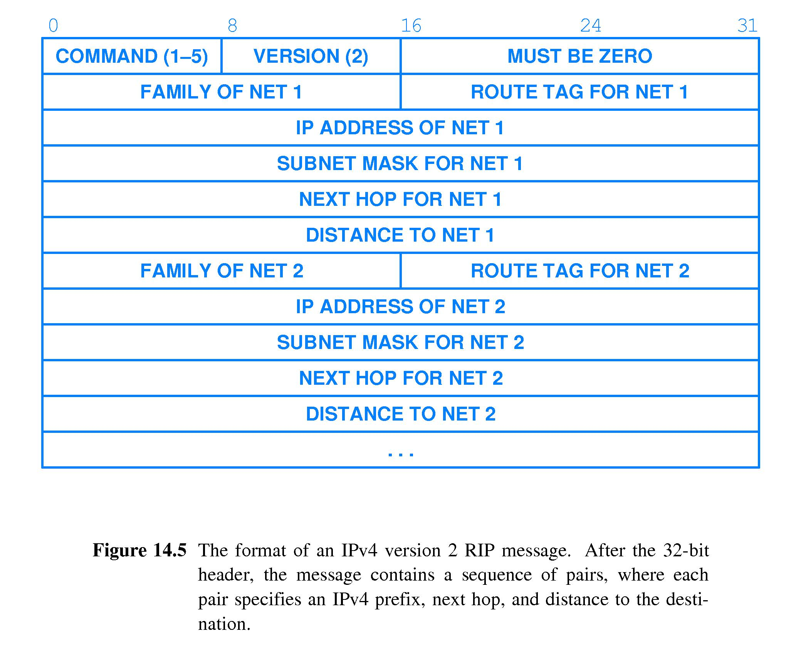
RIPv2 Message – improved performance

Slide 42
Description of Fields
Command - Indicates whether the packet is a request or a response.
Version - Specifies the RIP version used. For RIP 2 this value is set to 2.
IP address - Specifies the IP address for the entry.
Subnet mask - Contains the subnet mask for the entry. If this field is zero, no subnet mask has been specified for the entry.
Next hop - Indicates the IP address of the next hop to which packets for the entry will be forwarded (new in RIPv2)
Metric - Indicates how many hops (routers) will be traversed in the path to the destination. This value is between 1 and 15 for a valid route, or 16 for an unreachable route.
With Next Hop Field –> Router C would have noticed that Router B
was basing its hop count (2) to Net 4.0.0.0 on a route via itself - Router C
Next Hop prevents this type of count to infinity problem

Slide 43
RIP Message Exchange
two types of messages:
Request messages
request asks that a router send all or a part of its routing table
Response messages
response can be
an unsolicited regular routing update
a reply to a request
a triggered update
responses contain routing table entries
multiple RIP packets used to convey information from large routing tables.

Slide 44
Routing with RIP
Initialization: Send a request packet (multicast) on all interfaces requesting routing tables from neighboring routers:
RIPv2 uses multicast address 224.0.0.9
Request received: Routers that receive request send their entire routing table in a response message
Response received: Update the routing table
Periodic updates: Every 30secs, send routing table to every neighbor in a response message
Triggered updates: Whenever the metric for a route changes, send updated routing entry

Slide 45
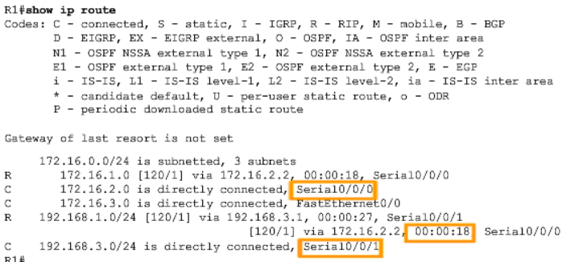
Router Routing Table with Dynamic Routing Entries
When a dynamic routing algorithm adds a route to a router’s routing table it will show which entry was added by which algorithm
B for BGP
O for OSPF
R for RIP
C for directly connected
S for static
All dynamic routes are via another hop
Default route has to be added statically – here not set

Slide 46
RIP Summary and slow demise
low overhead – fully distributed … BUT……
slow convergence
limited to 15 hops (max path cost → infinity =16) -> only practical in small networks
problems: cycle formations and count to infinity
addition of next hop in advertisement message helps with preventing cycle formation and cuts down on count to infinity
no longer that popular due to increased size in networks and diversity in types of flows
Rest in Peace (RIP)

Slide 47
OSPF (Open Shortest Path First)
OSPF is a Link State based Protocol
OSPF is the most important link state routing protocol on the Internet
History
1989: RFC 1131 OSPFv1
1991: RFC1247 OSPFv2
CIDR based – classes routing
1994: RFC 1583 OSPFv2 (revised)
1997: RFC 2178 OSPFv2 (revised)
1998: RFC 2328 OSPFv2 (current version for IPv4)
2008: RFC 5340 OSPF Version 3
support for IPv6

Slide 48
OSPF Basics:
it is a link state based routing algorithm that is fairly complex with high overhead
each node establishes a relationship (adjacency) with its neighbors
once established they exchange link state info
each node generates link state advertisements (LSAs) which are distributed its neighbors and “control” flooded to all other nodes
Router-LSA = (router ID, list of links of router)
each node stores all the LSA in a database (link state database LSDB) -> has complete topology information
each node has the same map of topology – all LSDBs have same LSAs
route computation using Dijkstra’s algorithm
quick convergence

Slide 49
Operation of a Link State Routing protocol
Received LSAs
Dijkstra’s
Algorithm
IP Routing Table
Link State Database
Router’s multicast their LSAs on all their outgoing interfaces
Received LSAs are “control” flooded to other outgoing interfaces
(controlled -> don’t send old/repeat information – use seq#)

Slide 50
OSPF - Example network
Router IDs are often set to one of the interface addresses, but can be set otherwise.
-> often the highest IP address, highest Loopback address or set statically at configuration time

Slide 51
OSPF metric
Link costs are called metric
Metric is in the range [1 , 2¹⁶-1]
Metrics of a link can be asymmetric
Metrics are set for an interface
Cost to a destination is the sum of the metrics of all traversed outgoing interfaces
Cost at R1 to R6 (10.1.7.6): 12
Cost at R6 to R1 (10.1.1.1): 15
4
5
4
5
4
5

Slide 52
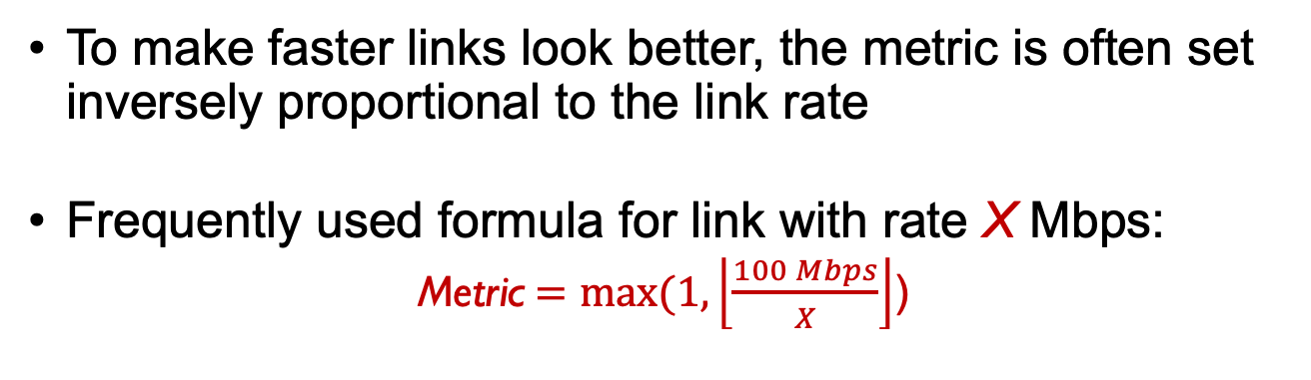
OSPF metric
To make faster links look better, the metric is often set inversely proportional to the link rate
Frequently used formula for link with rate X Mbps:
Metric$=max⁡(1, \left\lfloor \frac{100 Mbps}{X}\right\rfloor$)
Link rate | Metric
100 Mbps | 1
1.544 Mbps (T1) | 64
10 Mbps | 10
1 Gbps | 1

Slide 53
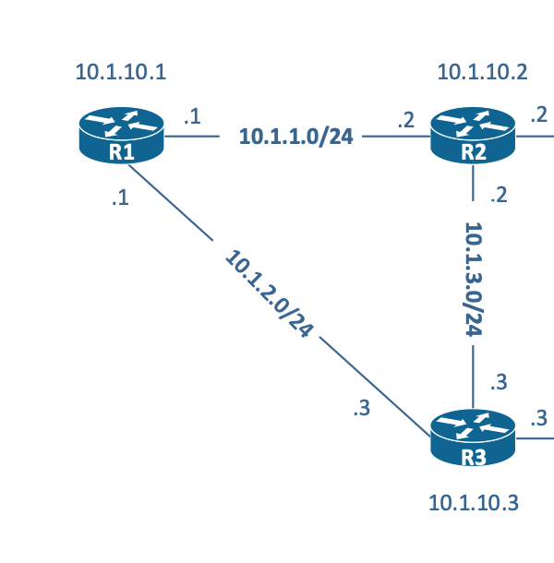
Link State Advertisements (LSAs)
The Router-LSA of router 10.1.10.1 is:
Link State ID: 10.1.10.1 = Router ID
Advertising Router: 10.1.10.1 = Router ID
Number of links: 4 = 2 links + 2 subnets
Link 1: Point-to-Point, myIP = 10.1.1.1, remoteIP = 10.1.1.2, metric = 64
Link 2: Subnet, 10.1.1.0/24, metric = 64
Link 3: Point-to-Point, myIP = 10.1.2.1, remoteIP = 10.1.2.3, metric = 64
Link 3: Subnet, 10.1.2.0/24, metric = 64

Slide 54
OSPF: Basic Operation
routers pick/select an ID
routers create a link state database (LSDB) and populate it initially with information from their own interfaces
(link id, state of the link, cost, neighbors of the link, subnet info)
routers establish a relationship (“adjacency”) with neighbors – “hello” message exchange
routers send database descriptor (DD) to their neighbors – summary of their LSDB
adjacent routers compare received DD, if they detect missing information they send a request for more information (either to update old link state info or get info for a new link)
routers respond with a link state update (LSU) that contains link state advertisements (LSAs) giving more detailed information.
routers continuously update their LSDB with neighbor information triggered by a change in link state
note that each link state entry in the LSDB has a seq# (identifies age of link state information)
used to determine if current entry in LSDB needs to be updated with received info in LSU
all routers have an identical link-state database – they all eventually have each others link states

Slide 55
Steps to Convergence via Link State Exchange
Router ID selection
Neighbor discovery
Reaching Adjacency
Initial data exchange of database content
Request to update data in database

Slide 56
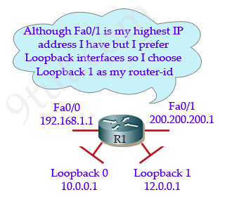
Router 1D Selection

Slide 57
Discovery of Neighbors
Routers multicast OSPF Hello packets on all OSPF-enabled interfaces.
If two routers share a link, they can become neighbors, and establish an adjacency.
Certain parameters have to be the same in neighbors to enable ”adjacency”.
In broadcast environments, adjacency is only established with Designated and BackupDesignated Routers (more on that later).
After becoming a neighbor, routers exchange their link state databases

Slide 58
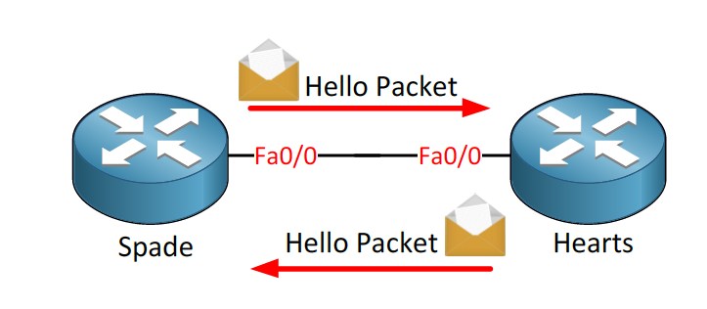
Hello Packet Exchange

Slide 59
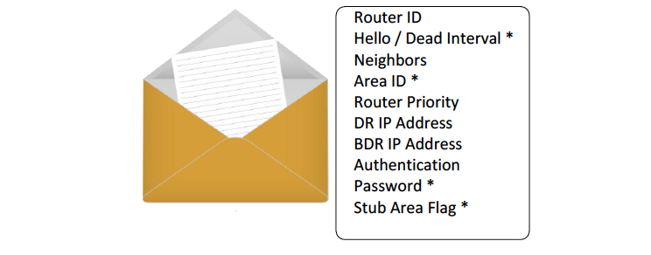
Hello Packet Content
* Indicates values that have to be the same for both routers if they are
to establish an adjacency, i.e., become neighbors

Slide 60
Exchange DD or DBD packets
R1 and R2 are “adjacent” neighbors
The neighbors must first determine who will be the master and who will be the slave. The router with higher Router-ID becomes master and initiates the link state info exchange.
They start by sending Database Description (DD or DBD) packets which contain an abbreviated list of the router’s link-state database
The receiver acknowledges a received DD packet by sending an its DD packet to the sender.
Each DD packet has a sequence number and only the master can increment sequence numbers.

Slide 61
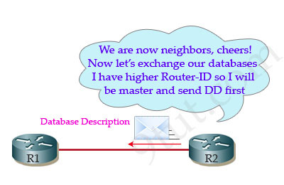
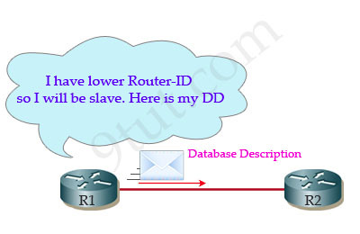
DD Message Exchange

Slide 62
Updating the LSDB
Routers first exchange DD msgs that only list the content of the LSDB but no details.
Once a router gets that info, it can then check to see if it has that information in its LSDB or if the information is outdated.
If it is missing info or it is has outdated records, it sends a link state request (LSR) requesting specific information regarding those links.
The neighbor responds with a Link State Update that contains Link State Advertisements (LSA) with detailed information for each requested link state.
The router will ACK the response and update its LSDB.
Both neighbors can request updates.
Recall that each link state entry in the LSDB has a seq# that is used to identify the “newness” of the information.

Slide 63
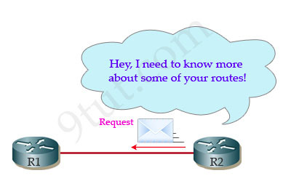
LSA Request
R1 or R2 can send Request to get missing LSA from its neighbors

Slide 64
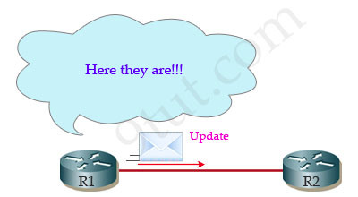
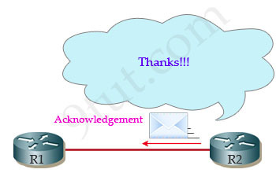
LSA Exchange
R2 sends back an LSAck packet to acknowledge the packet

Slide 65
Example of DD exchange
DD: only headers of
LSAs
Notices missing
Record: 10.1.10.2
(its own link)
Sends it
ACK

Slide 66
LSA exchanges between routers
10.1.10.2 explicitly requests each LSA from 10.1.10.1
10.1.10.1 sends requested LSAs in an update LSA
10.1.10.2 has a more recent LSA (serves as implicit ACK)

Slide 67
States of Establishing Adjacency
Init state – router has received Hello message from other OSFP router
2-way state – neighbor has received Hello message and replied with a Hello message of his own
Exstart state – beginning of the routing data exchange between both routers
Exchange state – DBD (Database Descriptor) packets are exchanged. DBDs contain LSAs headers. Routers see what LSAs they need.
Loading state – one neighbor starts by sending LSRs (Link State Requests) for every network it doesn't know about. The other neighbor replies with the LSUs (Link State Updates) which contain information about requested links.
After all the requested information has been received, the other neighbor goes through the same process
Full state (adjacency) - both routers have synchronized databases and are fully adjacent with each other.

Slide 68
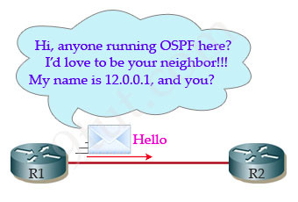
New neighbor adjacency request
R1 just comes up and R2 is already up and running.
R1 wants to find out if it has any neighbor running OSPF:
it sends a Hello message to the multicast address 224.0.0.5.
this is the multicast address for all OSPF routers and all routers running OSPF will process this message.

Slide 69
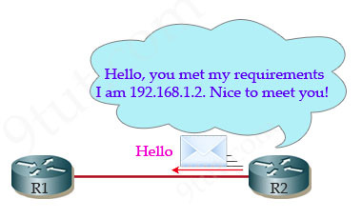
Hello Msg Adjacency Parameters
An OSPF router will receive the OSPF Hello packet and it will check some
required parameters to determine if adjacency can be established.
If all is in order:
R2 will add R1 to its neighbor table and send a Hello packet to R1
They then exchange DDs and the process of LSA exchanges occurs

Slide 70
LSA updates
periodically a node floods its LSDB (approx. every 30mins) by sending it to its neighbors
triggered updates- routing updates only when a change occurs in the network topology
when a link changes state, the device that detected the change creates a link-state advertisement (LSA) concerning that link and sends it to all neighboring devices using a special multicast address. neighbors then pass it on to their neighbors - flooding
each node that receives an update LSA reads it:
the LSA has a sequence number that allows the router to check to see if it has already seen that update (all link info is stored with a seq#)
if old, it is discarded, if new, LSDB info updated and the received LSA is “flooded” to its neighbors (note: controlled flooding - not sent in direction LSA was received from).

Slide 71
Reliable Delivery of LSAs
When a router receives an LSA it sends an ACK
Acknowledgements of LSA-updates- a rotuer receives
explicit ACK, or
implicit via reception of an LSA-Update from a neighbor that reacts to the received LSA with its updated information

Slide 72
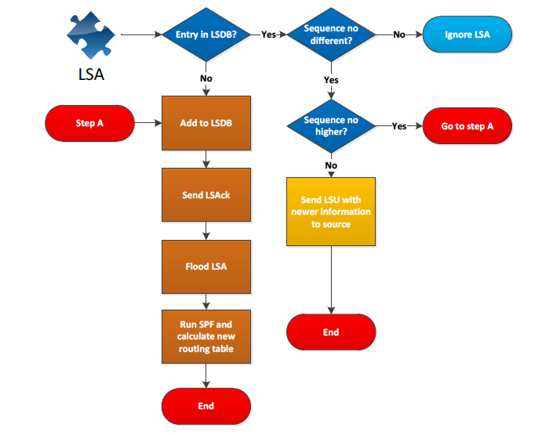
Flow Chart

Slide 73
OSPF Link State Packets
There are five types of Link-State Packets (LSPs).
hello: are used to establish and maintain adjacency with other OSPF routers. They are also used to elect the Designated Router (DR) (highest IP address –> Router ID) and (BackupDesignated Router (BDR) when on multi-access networks).
database description (DBD or DD): contains an abbreviated list (links and seq#) of the sending router’s LSDB and is used by receiving routers to check against their local LSDB to make sure it has the latest information (seq# indicates age of info).
link-state request (LSR): used by routers to request more information about any entry in the DBD
link-state update (LSU): used to reply to LSRs as well as to announce new information (updates). LSUs can contain 7 different types of Link-State Advertisements (LSAs)
link-state acknowledgement (LSAck): sent to confirm receipt of an LSU message (note OSPF does not use TCP)

Slide 74
OSPF Packet Format
OSPF packets are not carried as UDP or TCP payload!
OSPF has its own IP protocol number: 89
TTL: set to 1 (in most cases)
Destination IP: neighbor’s IP address or multicast address for a broadcast environment:
224.0.0.5 (ALLSPFRouters) or 224.0.0.6 (AllDRouters: (designated and backup designated only)

Slide 75
Designated Router
Routers report their links to other routers
On a LAN, each pair of routers is a link
Number of pairs grow quadratically with the of number of routers on a LAN:
→ N routers, N(N-1)/2 pairs
OSPF avoids this, by having a designated router (DR) for each LAN
One router becomes the DR
DR sends a single Network-LSA for the LAN, which contains the list of all routers connected to this LAN
Also (as before) each router sends a Router-LSA

Slide 76
OSPF “advanced” features
security: all OSPF messages authenticated (to prevent malicious intrusion)
load balancing: multiple same-cost paths allowed (only one path in RIP) for load balancing
TOS: for each link, multiple cost metrics for different classes of service (e.g., satellite link cost set low for best effort traffic; but high for real-time services, such as video) – creates different topology maps and as such different routing tables for each class
multicast: integrated uni- and multi-cast support:
Multicast OSPF (MOSPF) uses same topology data base as OSPF
hierarchical: OSPF in large domains.

Slide 77
Hierarchical OSPF
boundary router
backbone router
backbone
area
border
routers
area 3
internal
routers
area 1
area 2

Slide 78
Hierarchical OSPF
two-level hierarchy: local area, backbone
link-state advertisements only flooded within an area (local or backbone)
each router in an area (local or backbone) has:
detailed area topology;
direction (shortest path) to networks in other areas obtained from border routers.
backbone & local area routers: only use OSPF internal to their area
area border routers:
“summarize” distances to networks in own area
advertise to other Area Border routers to share with routers in their area
boundary (aka gateway) routers: connect to other AS’es

Slide 79
Chapter 5: outline
5.1 introduction
control Plane
autonomous Systems
5.2 routing protocols
link state
distance vector
5.3 intra-AS routing in the Internet:
RIP
OSPF
5.4 inter-AS routing in the Internet BGP

Slide 80
Internet inter-AS routing: BGP
BGP (Border Gateway Protocol): the de facto inter-domain routing protocol (v4)
“glue that holds the Internet together”
BGP provides each AS a means to:
e(xternal)BGP: obtain destination (network) reachability information from neighboring ASes
i(nternal)BGP: propagate reachability information to all AS-internal routers
determine “good” routes to other networks based on reachability information and policy
allows a network to advertise its existence to rest of Internet: I am here
uses TCP for reliable communications to transmit routing messages

Slide 81
eBGP, iBGP connections
2b
∂
2a
2c
1b
3b
2d
∂
1a
1c
3a
3c
AS 2
1d
3d
AS 1
eBGP connectivity
AS 3
iBGP connectivity
1c
gateway routers run both eBGP and iBGP protools

Slide 82
BGP basics
when AS3 gateway router 3a advertises path AS3, X to AS2 gateway router 2c:
AS3 promises to AS2 it will forward datagrams towards network X
BGP session: two BGP routers (“peers”) exchange BGP messages over semi-permanent TCP connection:
BGP is a “path vector” protocol: routers advertise paths to different destination networks
AS 3
3b
AS 1
1b
3a
3c
1a
1c
AS 2
2b
3d
X
1d
2a
2c
BGP advertisement:
AS3, X
2d

Slide 83
Path attributes and BGP routes
advertised network (referred to as prefix in BGP) includes BGP attributes
prefix + attributes = “route”
three important attributes:
ORIGIN: advertising AS
AS-PATH: list of ASes through which advertisement has passed
NEXT-HOP: indicates specific internal-AS router to next-hop AS
Policy-based routing:
gateway receiving route advertisement uses import policy to accept/decline path (e.g., policy: never route through AS Y).
AS export policy also determines whether to advertise path to other neighboring ASes

Slide 84
BGP path advertisement
AS3
3b
AS1
1b
3a
3c
1a
1c
AS2
2b
3d
X
1d
AS3,X
AS2,AS3,X
2a
2c
2d
AS2 router 2c receives path advertisement AS3,X (via eBGP) from AS3 router 3a
based on AS2 import policy, AS2 router 2c accepts path AS3,X, and propagates (via iBGP) to all AS2 routers
based on AS2 export policy, AS2 router 2a advertises (via eBGP) path AS2, AS3, X to AS1 router 1c

Slide 85
BGP path advertisement
AS3
3b
AS1
1b
AS3,X
3a
3c
1a
1c
AS2
2b
3d
X
1d
AS3,X
AS2,AS3,X
2a
2c
2d
gateway router may learn about multiple paths to a destination (here X):
AS1 gateway router 1c learns path AS2,AS3,X from 2a
AS1 gateway router 1c learns path AS3,X from 3a
If AS1 gateway router 1c chooses path AS3,X, it advertises path within AS1 via iBGP

Slide 86
BGP, OSPF, forwarding table entries
Q: how does router set forwarding table entry to distant prefix?
E.g.: router 1d in AS1
AS3
3b
AS1
1b
AS3,X
1
AS3,X
3a
3c
1a
2
1c
local link interfaces
at routers 1a, 1d
AS2
2b
3d
X
2
1d
1
AS3,X
AS2,AS3,X
2a
2c
physical link
2d
dest
interface
recall: 1a, 1b, 1d learn about dest X via iBGP from 1c: “path to X goes through 1c”
…
…
…
…
X
1
1d: OSPF routing: to get to 1c, forward over outgoing local interface 1

Slide 87
BGP, OSPF, forwarding table entries
Q: how does router set forwarding table entry to distant prefix?
E.g.: router 1a in AS1
AS3
3b
AS1
1b
1
3a
3c
1a
2
1c
AS2
2b
3d
X
1d
2a
2c
2d
dest
interface
recall: 1a, 1b, 1d learn about dest X via iBGP from 1c: “path to X goes through 1c”
…
…
…
…
X
2
1d: OSPF intra-domain routing: to get to 1c, forward over outgoing local interface 1
1a: OSPF routing: to get to 1c, forward over outgoing local interface 2

Slide 88
BGP route selection
gateway router may learn about more than one route to destination AS, selects route based on:
local preference value attribute: policy decision –picks highest value
shortest AS-PATH
closest NEXT-HOP internal router: hot potato routing
additional criteria
Local pref = 10
Local pref = 100
AS 5
Local pref = 50
Local pref = 80
shortest AS-PATH may not mean shortest router/hop path
Cost = 5
Cost = 30
best cost intra path may not mean best cost overall (5+30> 20+5)

Slide 89
Selective transit
Private Network
Example:
AS 3 carries traffic between AS 1 and AS 4 and between AS 2 and AS 4
But AS 3 does not carry traffic between AS 1 and AS 2
The example shows a routing policy. In other words, AS3 is perfectly capable of carrying AS1 -> AS2 traffic, but a policy decision prevents AS1 and AS2 from using AS3 to reach each other. (maybe private network connects AS1 and AS2?)

Slide 90
Customer/Provider and Peers
peers
peers
a stub network typically obtains access to the Internet through a transit network. E.g., AS7 –> AS5 –> AS 8
a transit network that is a provider may be a customer of another network (provider) – AS4 is a customer of AS2 as is AS5.
customer pays provider for service

Slide 91
Customer/Provider and Peers
peers
(ISPs level2)
peers
(ISPs level1)
peers (stubs)
stubs can have peer relationships – direct link, carries no transit
transit networks can have a peer relationship
peers provide transit between their respective customers
peers do not provide transit between peers, i.e., traffic from AS1 to AS3 cannot go through AS2.
peers have to go up one layer to reach another peer if not directly connected
peers normally do not pay each other for service

Slide 92
BGP: achieving policy via advertisements
legend:
provider
B
network
X
W
A
customer
C
network:
Y
A,B,C are provider networks (transit AS)
X,W,Y are customer (of provider networks) - stub networks, i.e., originate/terminate traffic only
X is dual-homed: attached to two networks
policy to enforce: X cannot route traffic from B to C via itself (X is a stub network)
.. so X will not advertise to B a route to C (export policy)
… whereas X does accept routes from C (import policy) and possibly other routes from B (import policy)

Slide 93
BGP: achieving policy via advertisements
legend:
provider
B
network
X
W
A
customer
C
network:
Y
Suppose an ISP only wants to route traffic to/from its customer networks (does not want to carry transit traffic between other ISPs)
A advertises path AW to B and to C
W is not B’s customer, B gets no “revenue” for routing any of its traffic.
B does not advertise (selective transit) BAW to X:
B uses import and export policy to make this decision, wont take (import) from A (or C) re W and won’t send (export) to X)
C will route W traffic and will let customers X and Y know about path CAW

Slide 94
Import and Export Policies
Best entry is entered in IP routing table
Policies
Based on attributes
Policies
BGP updates arrive
BGP updates depart

Slide 95
BGP interactions
BGP is executed between two routers
BGP session
BGP peers
procedure:
establishes TCP connection (port 179) to BGP peer
exchange all BGP routes
as long as connection is alive: Periodically send incremental updates
Note: Not all autonomous systems need to run BGP. On many stub networks, the route to the provider (if single ISP connection) can be statically configured

Slide 96
BGP Message Types
BGP messages exchanged between peers over TCP session
BGP messages:
OPEN (Type 1): opens TCP connection to remote BGP peer (port 179) and authenticates sending BGP peer
UPDATE (Type 2): advertises new path (or withdraws old)
KEEPALIVE (Type 3): keeps connection alive in absence of UPDATES; also ACKs OPEN request
NOTIFICATION (Type 4): reports errors in previous msg; also used to close connection

Slide 97
BGP routing information
BGP route advertisement is sent in a BGP UPDATE message
a route is announced as a Network Prefix, e.g., 10.0.1.0/24, and Attributes
Attributes specify details about a route:
Mandatory attributes:
ORIGIN
AS_PATH
NEXT_HOP
many other attributes

Slide 98
ORIGIN attribute
originating domain sends a route to a network (prefix - here 10.0.1.0/24) with ORIGIN attribute (AS number)
Network Prefix
10.0.1.0/24, ORIGIN {1}
10.0.1.0/24, ORIGIN {1}
10.0.1.0/24, ORIGIN {1}
10.0.1.0/24
10.0.1.0/24, ORIGIN {1}
10.0.1.0/24, ORIGIN {1}

Slide 99
AS-PATH attributes
each AS that propagates a route prepends its own AS number
AS-PATH creates a full path to reach the network prefix 10.0.1.0/24
path information prevents routing loops from occurring
path information also provides information on the length of a path (no. of ASes enroute, by default, a shorter route is preferred)
Note: BGP aggregates routes according to CIDR rules
10.0.1.0/24, AS-PATH {4,2,1}
10.0.1.0/24, AS-PATH {1}
10.0.1.0/24, AS-PATH {2,1}
10.0.1.0/24, AS-PATH {1}
10.0.1.0/24, AS-PATH {3,1}

Slide 100
NEXT-HOP attributes
each router that sends a route advertisement, includes the IP address of the forwarding port in a NEXT-HOP attribute
the attribute provides information for the routing table of the receiving router in the next AS on the path
10.0.1.0/24, NEXT-HOP {128.100.11.1}
10.0.1.0/24, NEXT-HOP {128.143.71.21}

Slide 101
Putting it all together
AS 3
3b
AS 1
1b
3a
3c
1a
1c
AS 2
2b
X
3d
1d
2a
2c
BGP advertisement:
X, 3a:f0/0, 3
BGP advertisement:
X, 2a:f0/0, 2,3
2d
Advertisement contains:
Advertised Network - prefix: X
IP address of Interface of next hop router on path: 2a:f0/0
list of ASes traversed: 2,3

Slide 102
BGP NEXT-HOP -> IGP information
E.g., how does R1 learn about route to 10.0.1.0/24???
ISP or Private Network
128.100.11.0/24
10.0.1.0/24, NEXT-HOP {128.100.11.1}
10.0.1.0/24, NEXT-HOP {128.100.11.1}
At R1:
IGP Routing table
Combined Routing table
At R1
Dest. | Next hop
128.100.11.0/24 | 192.0.1.2
Dest. | Next hop
128.100.11.0/24 | 192.0.1.2
10.0.1.0/24 | 192.0.1.2
iBGP info
Dest. | Next hop
10.0.1.0/24 | 128.100.11.1

